Slide 1
Leveraging the Power of Analytics: From Concept to Implementation
Paul O’Brien
Kendall St. Hilaire
Indian River State College
May 25, 2017

Slide 2
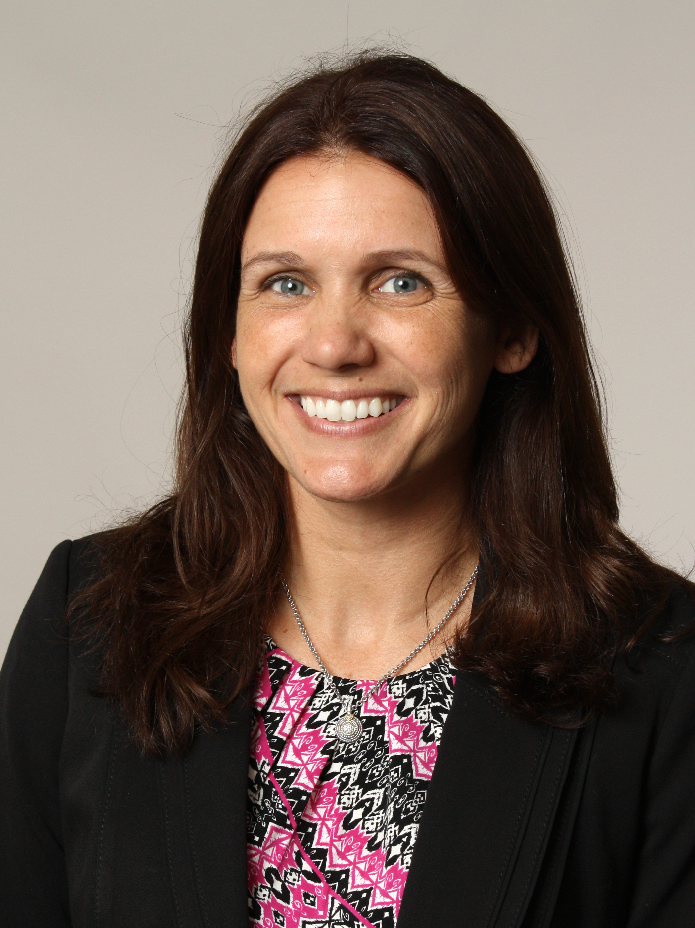
Today’s presenters
Add Photo
of Paul?
Add Photo
of Kendall
Paul O’Brien
VP of Institutional Technology
Indian River State College
pobrien@irsc.edu
Kendall St Hilaire
Administrative Director of the Virtual Campus
Indian River State College
ksthilai@irsc.edu

Slide 3
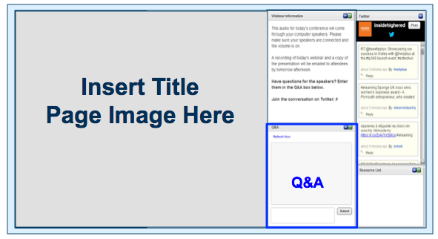
Before we begin
We are using On24 for today’s webinar. Please enter questions in the text field at the bottom of the Q&A Window. We are monitoring the discussion and will try to bring the Q&A comments into the conversation.
We are recording the webinar; the webinar archive and slides will be available in 24 hours.

Slide 4
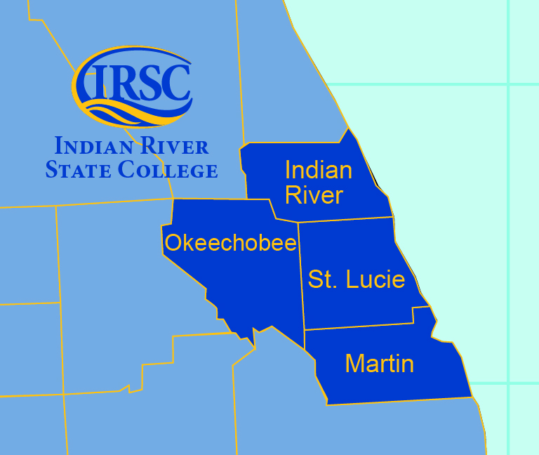
The IRSC story
Opened doors as Indian River Junior College in 1960
Became Indian River State College in 2008
Began offering baccalaureate degrees
28,000 headcount
14,000 FTE
Aspen Finalist with Distinction 2017

Slide 5
Some background
Performance-based funding in 2014
Changing definition of institutional success- inputs to outputs
Elimination of required remedial education
Change in students- over 60% receive financial aid -70% are working more than 30 hours per week

Slide 6
Indian River State College’s Virtual Campus
2012: Recommended by workgroup consisting of faculty, administrators and professional staff
2013: Launched the Virtual Campus
2017: Twelve degrees online and a headcount of 6,000 wholly-online students
Largest campus in terms of enrollment

Slide 7
Indian River State College’s Virtual Campus
Master course model:
Quality Matters (QM) coupled with instructional design expertise
Required for all faculty serving as SME’s
Required faculty training:
online pedagogy
tools within the Learning Management System (LMS), including proper use of the Blackboard Grade Center
Results:
167 faculty have achieved QM certification
185 faculty completed the Virtual Campus Instructor Training course (VCIT)

Slide 8
Leadership support
Collaborative executive leadership supports the Virtual Campus
Combined effort toward improving online student success from several key areas
Communication at faculty meetings and division meetings

Slide 9
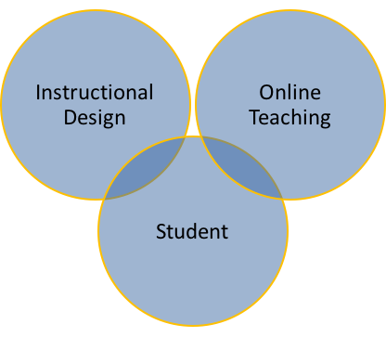
The three-pronged approach…
Instructional Design: Partnered instructional designers and faculty members to collaborate on master courses
Online Teaching: Professional development required of all online instructors
Student: Strong focus on the online student experience

Slide 10
…with the addition of analytics
Master course design allowed for an easy implementation of Analytics for Learn (A4L) in 2014
External Grade Column within Bb Learn links to analytics reports
Allows real-time tracking of student success in all courses

Slide 11
Analytics for Learn
Analytics reports provide a glimpse into the online classroom and online student behaviors
We are able to determine what is happening versus what happened

Slide 12
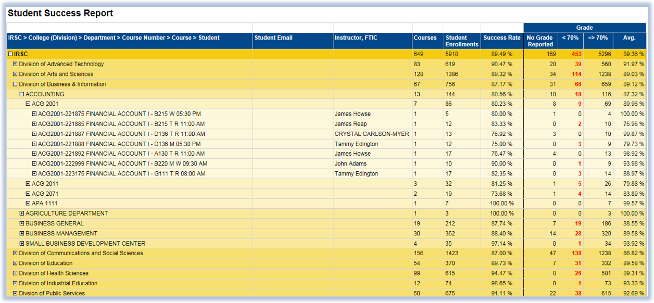
Analytics for Learn

Slide 13
Advisor-at-a-Glance report
Real-time actionable data allows for meaningful interventions
This report provides advisors a complete view of students in their caseload

Slide 14
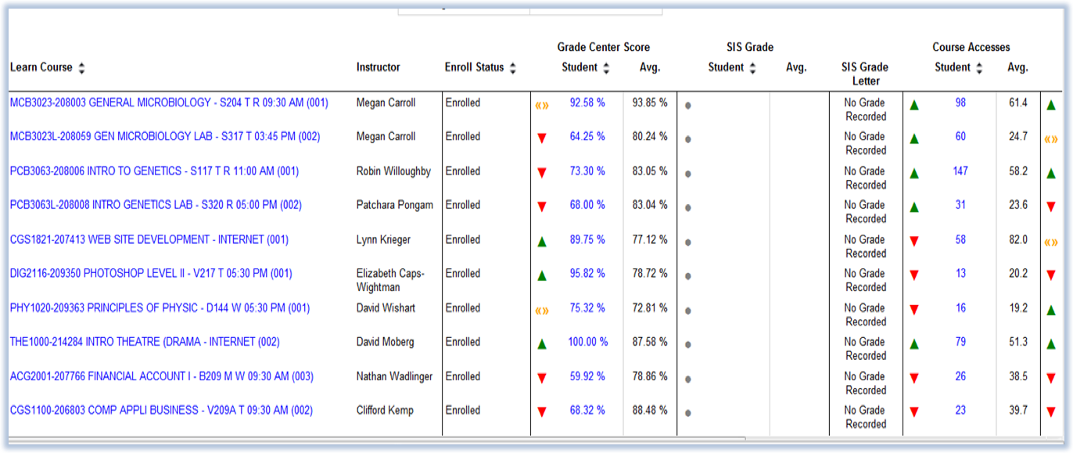
Advisor-at-a-Glance report

Slide 15
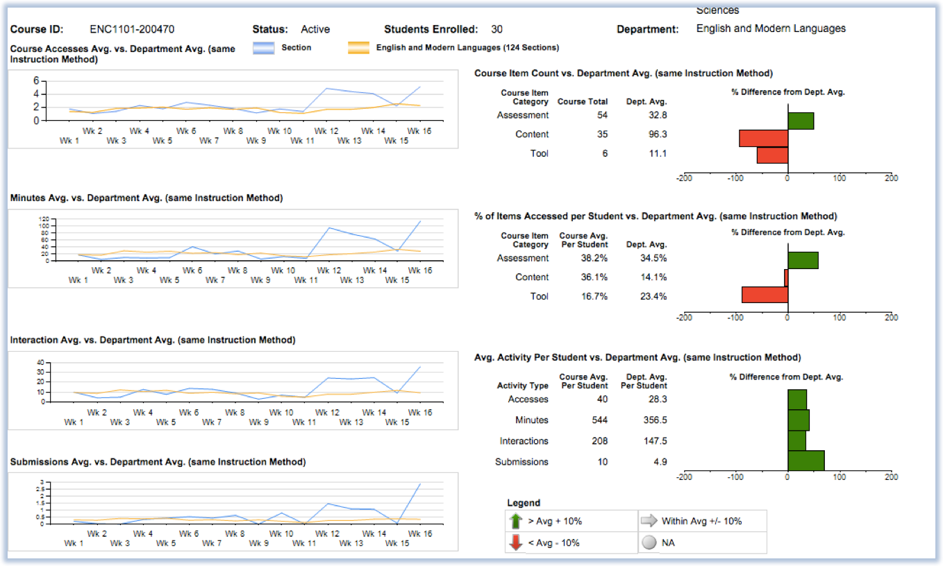
Course-at-a-Glance report

Slide 16
Results
Closed gap between online and face-to-face success rates by 4% in 2 years
Online course success rates jumped from 72% to 78%
Student graduation rate of students who took at least one online course is 5% higher than those who only took face-to-face courses
Data gleaned from the reports are conversation starters between deans and their faculty
New level of faculty/advisor collaboration around student success

Slide 17
Results
Greater levels of collaboration among faculty, advisors and Virtual Campus professional staff
Crosspollination of resources and efforts around online students in terms of preventions and interventions
Analytics will help to inform instructional design methods
Snapshots of master courses showed areas of weakness over multiple semesters (historical data)

Slide 18
What’s next at Indian River: Predictive analytics
Launched Blackboard Predict pilot in Spring 2017
17 faculty, 21 sections and 608 students
Predictive analytics tool based on an algorithm using SIS and Blackboard LMS data
Provides Week Zero data on students’ likelihood of earning a passing grade in the course
Algorithm is dynamic - IRSC built its model during pilot, which will continue to evolve over future semesters

Slide 19
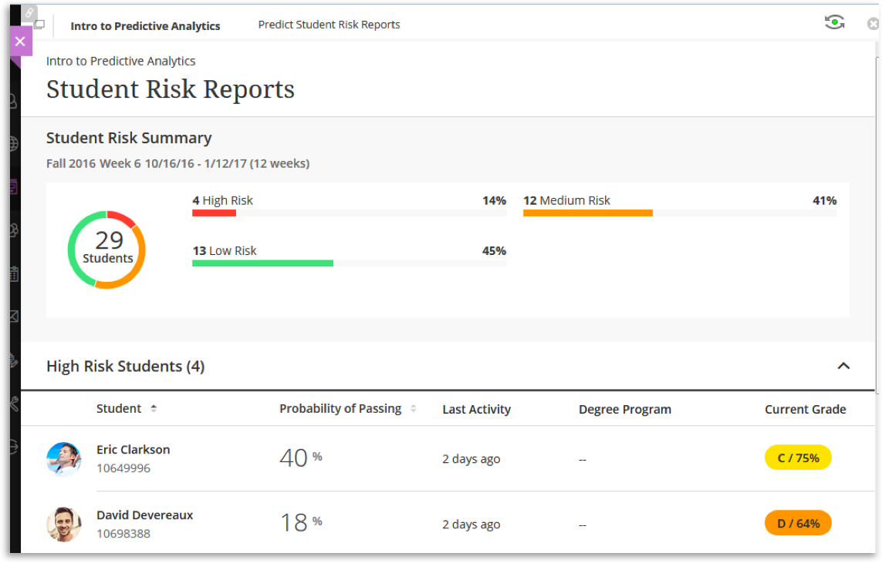
Blackboard Predict

Slide 20
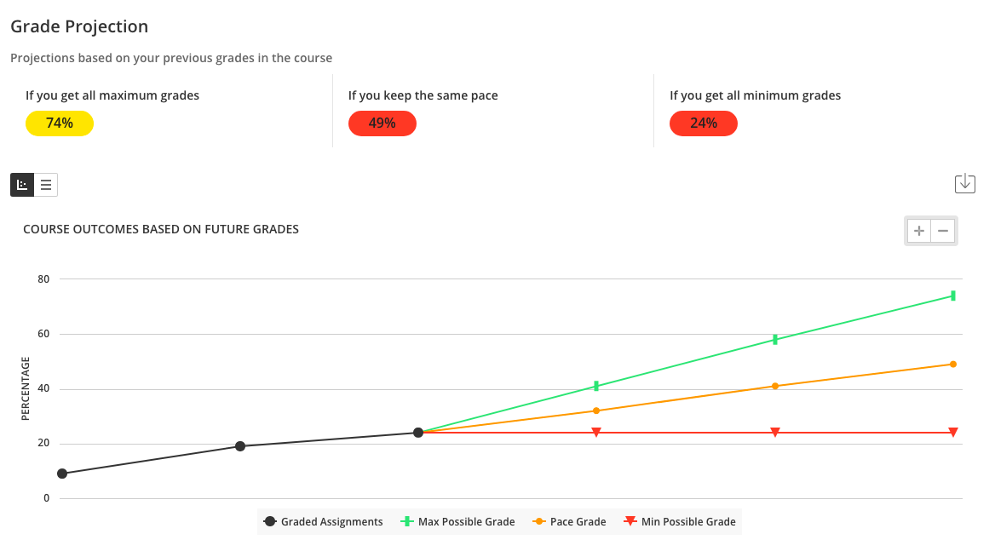
Blackboard Predict

Slide 21
Results of the Blackboard Predict Pilot
Some faculty have concerns about “labeling” students
Greater understanding that the prediction is not based on individual student data, but rather the profile of students like him or her
Advising would benefit from this information, especially prior to the start of the semester

Slide 22
Questions?

Slide 23
Resources and references
CASE STUDY
Analytics to help close the online-on campus success gap http://bit.ly/BbAnalytics_IRSC
MORE INFORMATION
Blackboard website
http://blackboard.com/analytics
Blackboard Analytics for Learn
http://bit.ly/A4LDataSheet
Blackboard Predict
http://bit.ly/BbPredict

Slide 24
Thanks to our presenters
Paul O’Brien
VP of Institutional Technology
Indian River State College
pobrien@irsc.edu
Kendall St Hilaire
Administrative Director of the Virtual Campus
Indian River State College
ksthilai@irsc.edu

Slide 25
Leveraging the Power of Analytics: From Concept to Implementation
Paul O’Brien
Kendall St. Hilaire
Indian River State College
May 25, 2017

